Slide 1

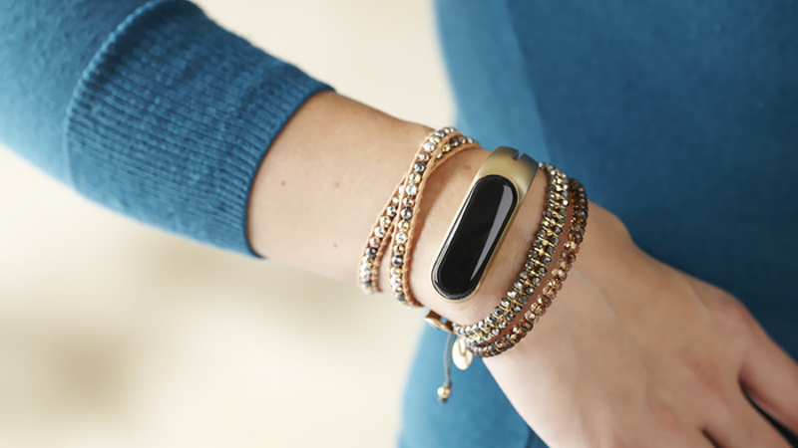
PRESENTERS:
ERCIN YILDIRIM
UTKU DORA OZDEMIR

Slide 2

The Problem
Sports
Same Features
Different designs
Fitbit
Jawbone
Sports
Nike
Sports
Misfit
Sports
Most common smart bracelet brands

Slide 3
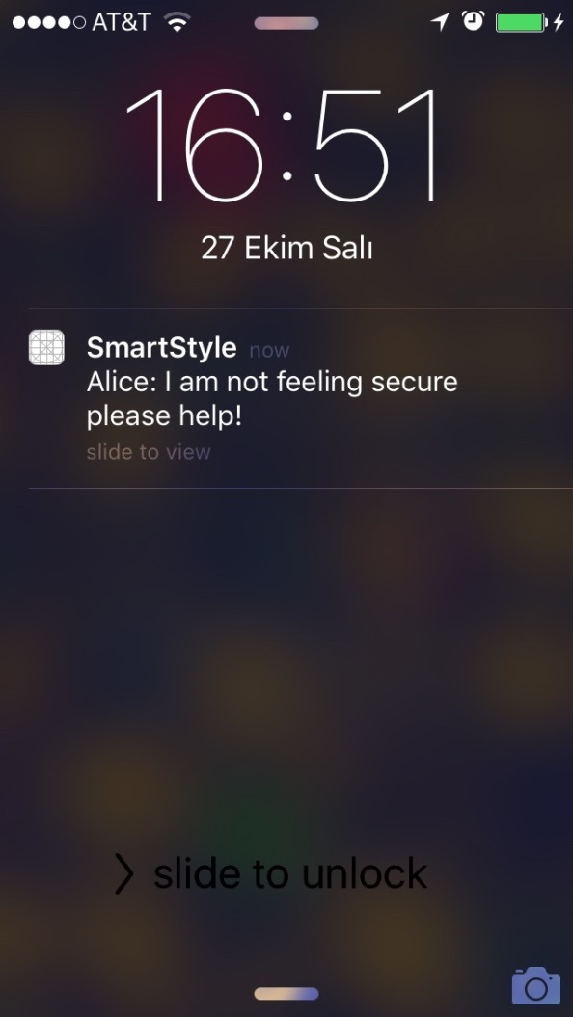
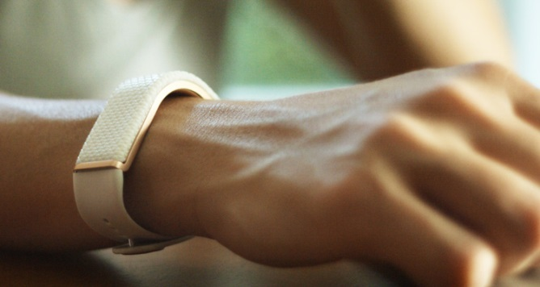
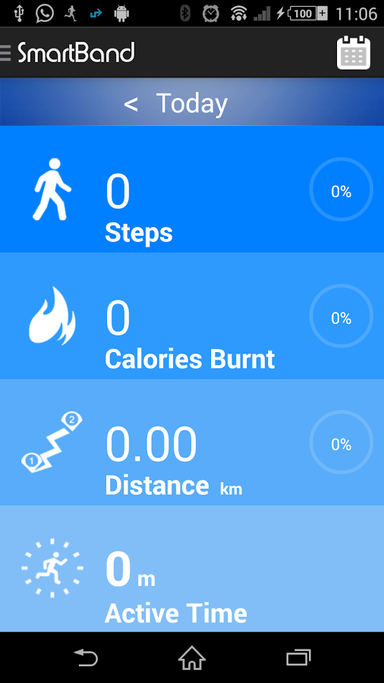
Loya Solution
What our business provides
Loya brings fashion and technology together

Slide 4




The Underlying Magic
Secret Sauce of Loya
Personal Security
Fashionable
Locking System
No need to charge

Slide 5




Go To Market Plan
How to Reach Customers
Efficient
Online Sales
Responsive
Quick
Kickstarter.com
Online Marketing
Flexible
Affordable
Global
Wholesale Distribution

Slide 6
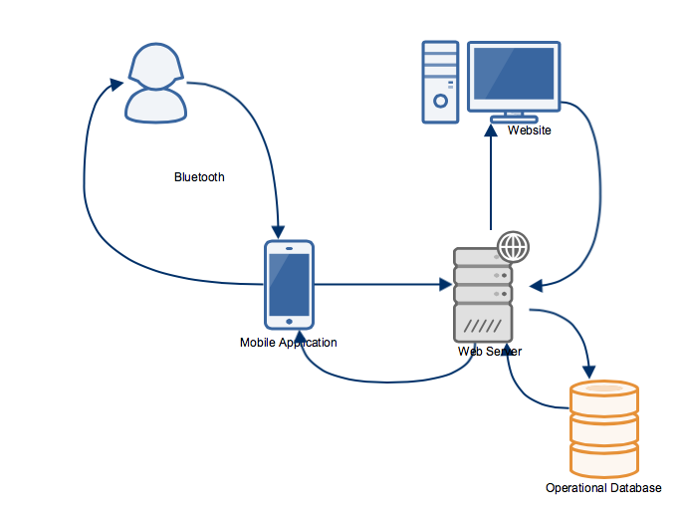
Overview Diagram

Slide 7
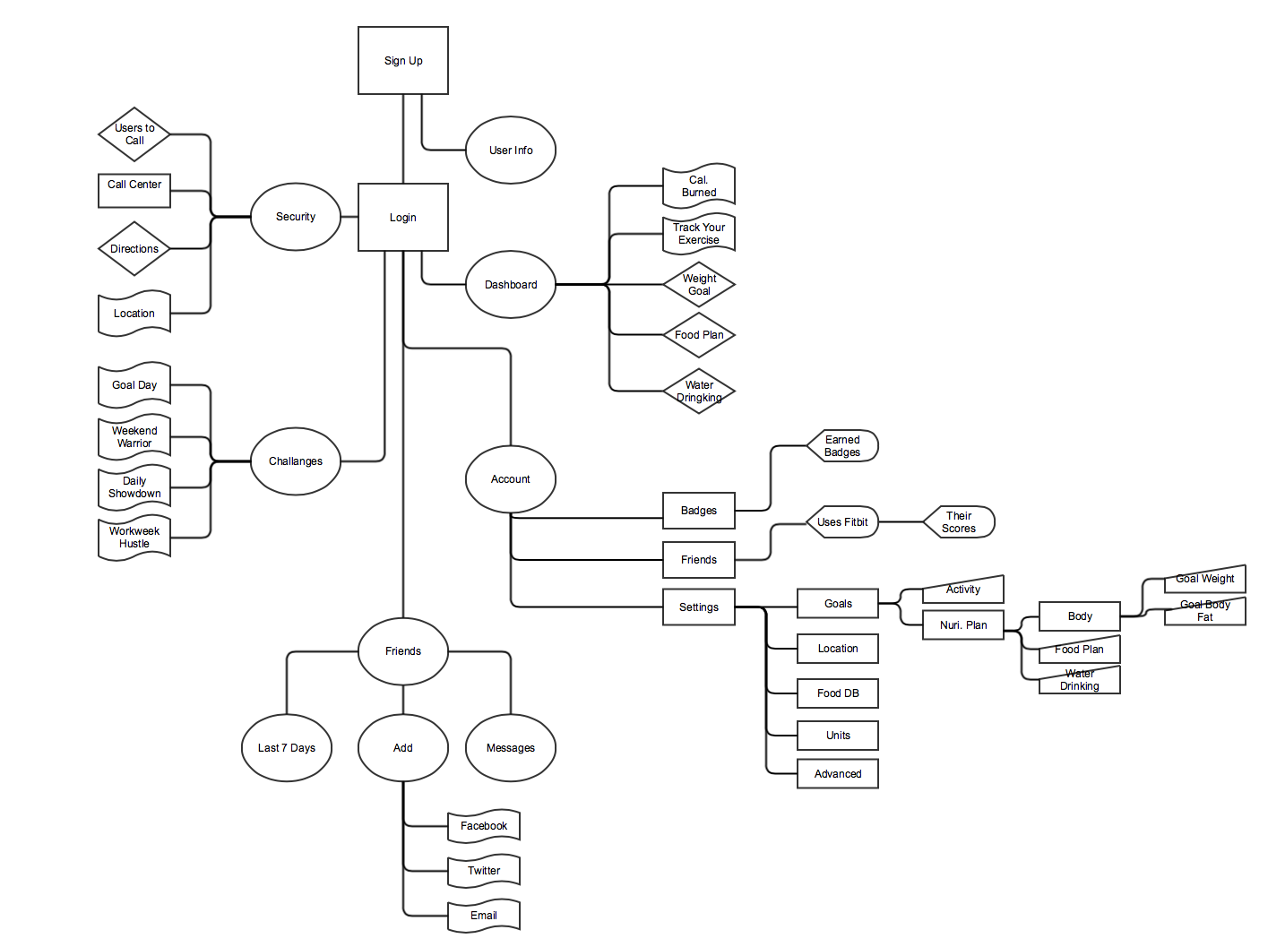
Mobile Application Flow Chart

Slide 8
Key Features Implemented
Security
- Logging in to a secure database through iPhone application
- Inform trusted contacts in one button (Push Notifications)
- Send, receive, and display current location(of the sender) easily with application
Activity Tracking
- Background step Counter (knows if running or walking)
- Active sport exercise counter (Sit Up Counter, Pull Up Counter)
- Detects activities rather than just using user input.

Slide 9
Challenges
Swift 2.0
  Security Protocols(Login, Push Notifications, Location Sharing )
  Apple licenses required to test
  Bluetooth Communication between devices
  Major revision to the language, only released a few months ago.
    Most of all code examples on the internet are broken/inapplicable.
    Very little documentation available.
Activity Tracking
  Detecting the exercise reliably is difficult.
  Figuring out how to use sensors.

Slide 10
Technical Background
Security
- Integration with iPhone and parse.com back-end server and database.
- Setting up basic data modeling in database.(Timestamps, Locations, Messages, Friends)
- Log in authentication protocols tested with pisano.co servers.
- Embedding data in push notifications like messages and locations.
- Displaying user location in the app after receiving an alert using UIMapKit Libraries

Slide 11
Technical Background
Activity Tracking
- Capturing the state and count of steps daily, weekly and monthly
- Counting some dynamic exercises(Sit-Ups, Pull-Ups) with different rotations with the use of sensors:
- Accelerometer - Mainly used on pull-ups. Also used for sit-up accuracy.
- Gyroscope - Mainly used on sit-ups.
- Magnetic Field Sensor - Maintain position and accuracy.
- Pedometer - Manipulating some of the built in functionalities to count steps.
- Deciding on thresholds
-Averaged the action thresholds decided for each iteration with different rotations in terms of their accuracy

Slide 12
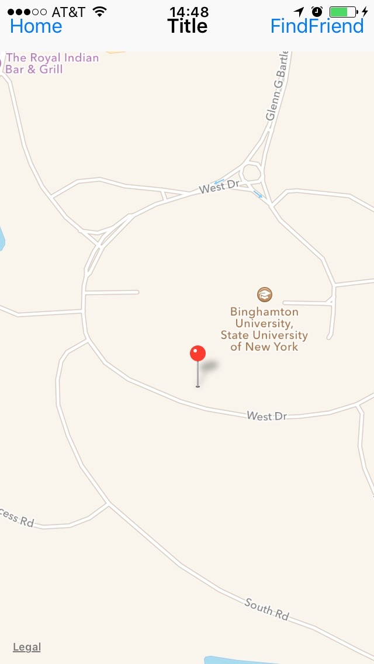
Locational Accuracy
We used CLManager and UIMapKit modules to get the best accuracy we could.

Slide 13
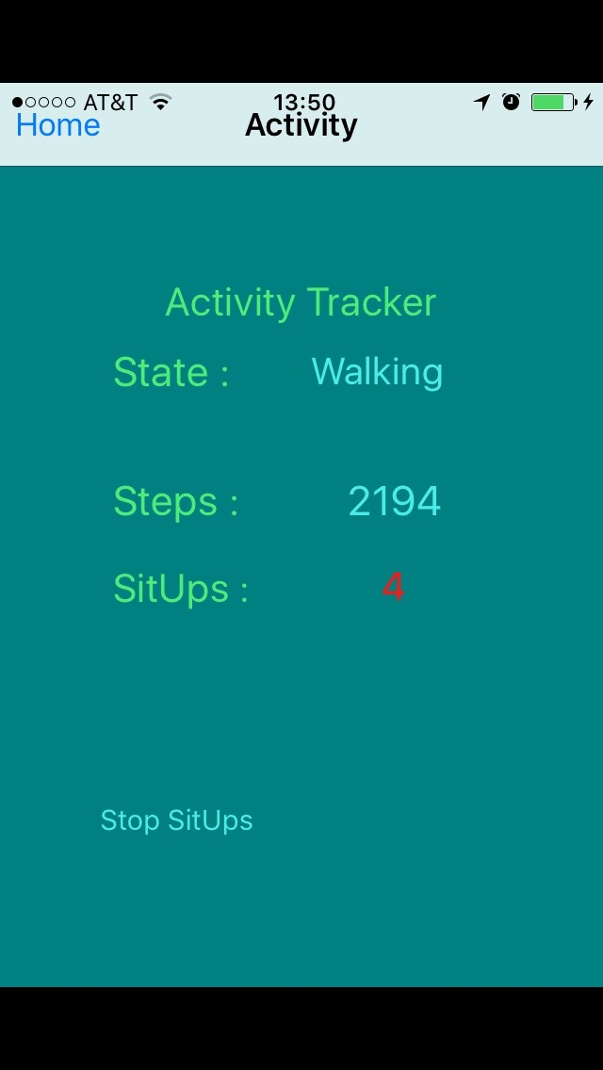
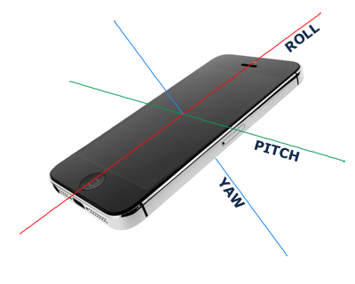
Rotational and Sensor Use
We used our algorithms and thresholds to come up with a way that we could sense the motion regardless of the positioning of the iPhone.

Slide 14
Near Future Objectives
- Implementing detailed, integrated database
- Creating a clean user interface where users can see and edit their preferences easily
- Providing alternative log in options
Improving exercise variety and implementing nutrition database where users can see calories spent and gained.
Creating a social environment for users to interact
Integrating all the functionality with physical bracelet
Implementing lock screen option when the user is away
And more …

Slide 15
Project Milestones For Spring 2016
Where we are & What we need to accomplish
Area | Dec | Jan | Feb | Mar | Apr | May | June | July
Marketing
Promotions
Distribution
Interface Design
Database + Webserver
Mob. App.

Slide 16
Questions ?

